Slide 1
Practice Session 5 Hiware Bazar

Slide 2
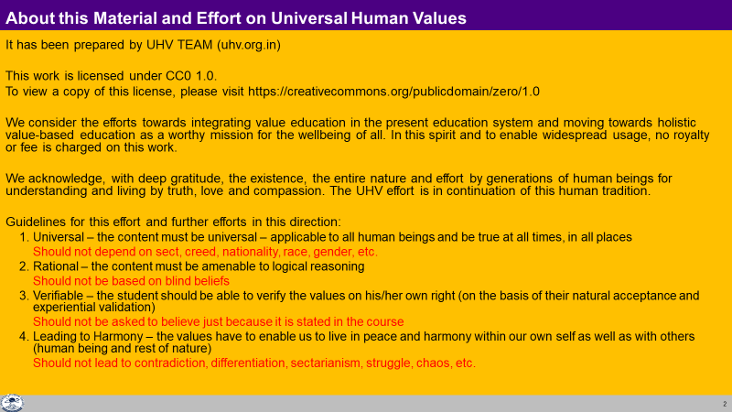

Slide 3
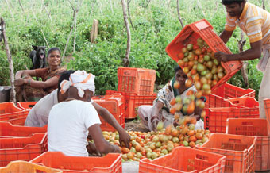
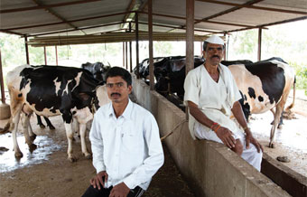
Hiware Bazaar
Watch the video "Hiware Bazaar" (23 Minutes)
It is a documentary about a progressive village in Maharashtra, India. It is about how good governance and people have made significant change in society
Source: https://www.youtube.com/watch?v=cb0Qvh9BJ0s

Slide 4
Hiware Bazaar
We will discuss your observations:
What is the goal of this village society?
What is the program followed by this village society?
Man influences society/system or man has to conform to society/system? Is there space in the current system for individuals to express themselves, to participate…
Reflect on your family goal, family program & participation of each member of your family…similarly for the community… society

Slide 5
26 Apr 2016 News
Hiware Bazar: An Oasis in Drought Hit Maharashtra
Rainfall 200-300 mm/year
Water table 40-80' in April 2016
No water tanker has been requested in last 21 years
Nearby villages in same district
Water table > 400'
Water crisis in April 2016
Source:
http://timesofindia.indiatimes.com/india/An-oasis-in-drought-hit-Maharashtra-village-sets-example/articleshow/51986348.cms

Slide 6
Summary – Hiware Bazar (Education-sanskar)
 | 1995 | 2012
School Curriculum | Defunct | Curriculum has compulsory course on water management 32 students studying medicine in nearby colleges
Liquor Shops | 22 | NIL
Sanitation | Open defecation | 100% toilets No sweepers hired by village – all work done by residents

Slide 7
Summary – Hiware Bazar (Justice-Suraksha)
 | 1995 | 2012
Families / Population | 182 / ? | 235 / 1,250 93 families have returned
Gram Sabha |  | Participative, Transparent
Forest | Grazing domestic cattle on forest land. Trees cut for firewood | 10 lakh trees planted 90% success rate. No grazing in forest – grow fodder instead. Babool trees in forest used to harvest gum
Girl Children |  | Second daughters marriage expenses borne by gram panchyat
Diversity |  | Mosque made by community for only muslim family
Collaboration |  | Community labour
Environment |  | No cars used within village – and outside use car pools; use cycles within village (gram sabha 2008)

Slide 8
Summary – Hiware Bazar (Production-Work, Exchange-Storage)
 | 1995 | 2012
Average Rainfall / Year | 400 mm | 400 mm (190 mm in 2010)
Irrigated Area | 20 hectares / 976 hectares | 70 hectares / 976 hectares
Water Conservation |  | 52 earthen bunds, 2 percolation tanks, 32 stone bunds, 9 check dams. Tubewell only for drinking water, not for agriculture
Wells / Water Level | 90 / 80-125 ft | 294 / 15-40 ft
Crops | Included sugarcane | Maize, jowar, bajra, onions, potatoes… planned after monthly water availability assessment. Now sugarcane is restricted to ½ acre & only for fodder
Organic farming |  | 20% chemical fertilisers → plan to go 100% organic soon
Milk Production / Day | 150 liters | 4,000 liters
Per Capita Income / Month | 830 | 30,000 (60 millionaires)
Families / Below BPL | 168 | 3 (Hiware Bazar puts it at12)

Slide 9
Summary – Hiware Bazar (Health-Sanyam)
 | 1995 | 2012
Primary Health |  | Open, transparent

Slide 10
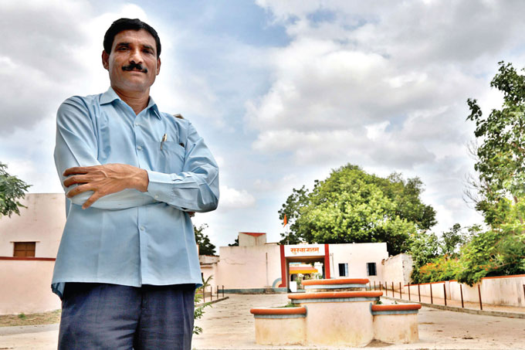
“I took 21 years to transform my village. Now I have zipped the strategy to take just 2 years. With community participation, we can create a new era of rural change”
Popatrao Pawar, Deputy Sarpanch 2012

Slide 11
This is an example of what people have done together
(there is still space to work for harmony in the current system)
After 21 Years… Hiware Bazaar Today (November 2012)
250-300 people visit Hiware Bazaar every day
Popat Rao Pawar has been made State minister, Chairman of Maharashtra's Model Village Programme
He has been given charge of 100 villages – to implement similar model
Contacts:
Mohan
Habib Sayyed (works on village water management)

Slide 12
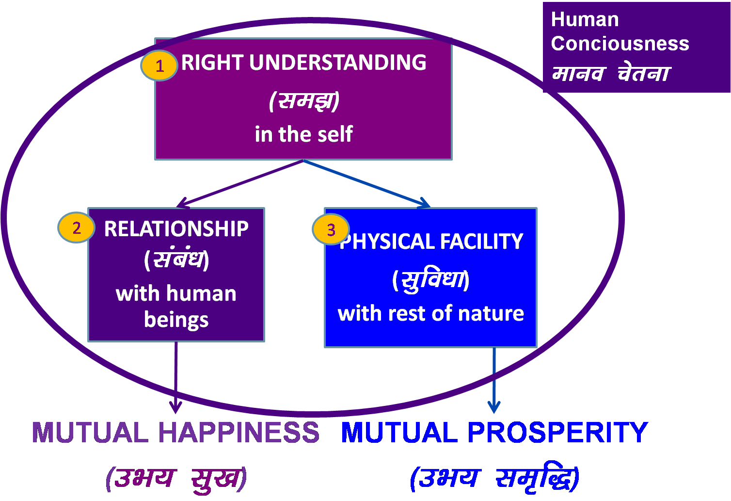
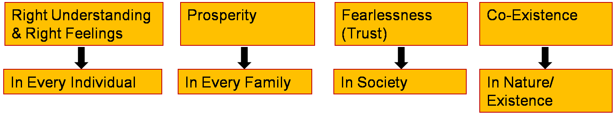
Human Society – Society based on Relationship, Co-existence
Family is the basic building block
of Society.
Family makes effort for
1. Justice
2. Prosperity
3. Participating in Human Society
Human Target – As a Society
Integrated Family, Society
Happiness

Slide 13
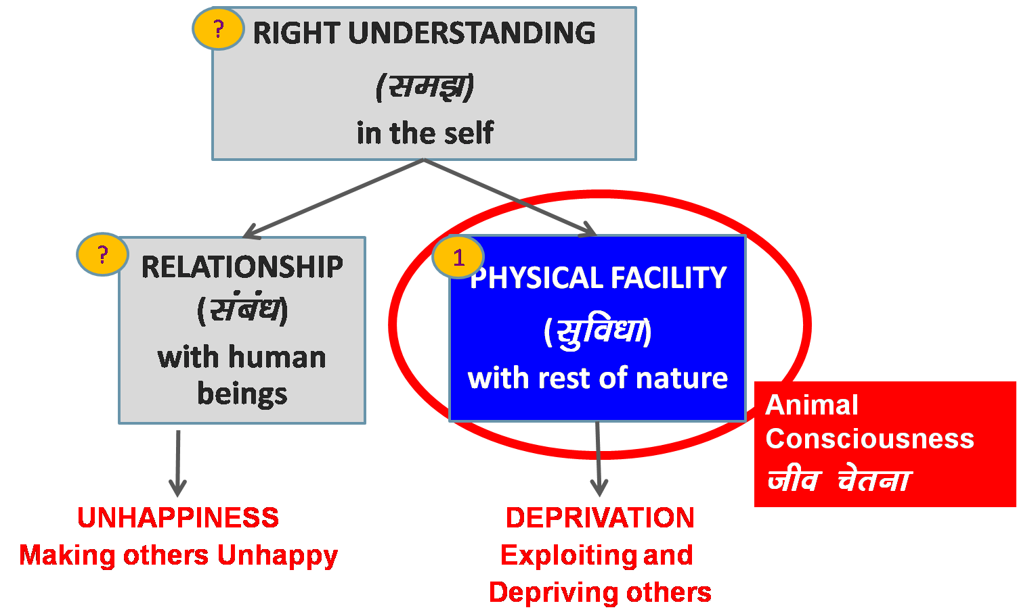
Crowd …
People living separately with
conflicting goals
in arbitrariness (manmani) /
opposition / struggle
Fragmented Family, Society
Assumptions (eg. Money is everything)
Accumulation
By Any Means
Domination &
Exploitation
Mastery &
Exploitation
In Every Individual
In few Individuals
In Society
Over Nature
Madness for Consumption Hkksx mUekn
Madness for Profit ykHk mUekn
Madness for Sensual Pleasure dke mUekn
Terrorism
War
Resource Depletion
Pollution

Slide 14
Survey 2002-2003
Itra – 2300 population. Income is 4 cr/year (2.58 cr/year just from Grain, Milk and Vegetables). As income increased, misuse of money increased. Expensive marriages…2 Bolero, 10 tractors, 50 motorcycles bought … most of them are idle (6 used to go to town for work)
Gurah – 2500 population. Mostly shuttering work. Monthly income is 9000; 3000 spent on liquor, gutka, gambling… competition to make pucca houses…
Sandila – 2200 population. Spends Rs 8 Lakhs/year on gutka (equivalent to food for 1200-1300 people for 1 year)
Is physical facility available in sufficient quantity?
Is there right utilization of available physical facility?

Slide 15
Current Situation
Rural urban migration (globally - 60% population in urban centres)
Villages being bought by corporations
Corporate farming
Farmers to laborers
Villages becoming labour centres / production centres for cities

Slide 16
Current Approach Work to be Done in Society
Problem – Liquor, Gutka
(or only symptom?)
Action taken to get rid of it – Do’s & Do’nts…
(or symptomatic relief – temporary?)
Clarity of All Encompassing Solution (Samadhan) Human Conduct, Human Education & Human Order
Effort for All Encompassing Solution
Problem – Analysis in the light of Samadhan – Inhuman Conduct (Liquor, Gutka… are only the symptoms… of temporary relief / escape)
Effort for getting rid of problem – Ensure Human Conduct, understanding of right utilisation

Slide 17
Some Indicators
1. Index of Understanding: % of Population with Right Understanding
e.g. % individuals who live with solution & response (who facilitate right understanding & relationship in others) vs problem & reaction (who are mostly talking about problems, get irritated, angry or quarrel)
2. Index of Prosperity: % of Prosperous Families
e.g. families that have recognised their need for physical facility and produce/have more than their need
3. Index of Fearlessness (Trust): % of People one has Trust on Intention – Unconditionally, Continuously
4. Index of Sustainability (Co-existence): Enrichment of Nature
e.g. Air Quality, Water Table, Water Quality, Average Annual Improvement of Soil Quality, Definiteness in Weather

